Slide 1
Introduction to Programming with Python

Slide 2

Section 1: Basic programming
1. Sequence types:
Tuples, Lists, and Strings
元组，列表，字符串
Notes:
最基本的数据结构是序列（sequence），序列中的每个元素被分配一个序号——即元素的位置，索引。

Slide 3
Sequence Types
1. Tuple
不可更改
A simple immutable ordered sequences of items
Immutable: a tuple cannot be modified once created
Items can be of mixed types, including collection types
2. Strings
不可更改
Immutable
Conceptually very much like a tuple
3. List
可以更改，可扩展
Mutable ordered sequences of items of mixed types

Slide 4
Sequence Types
The three sequence types (tuples, strings, and lists) share much
of the same syntax and functionality
Tuples are defined using parentheses (and commas)
>>> tu = (23, 'abc', 4.56, (2,3), 'def')
元组需要用（）来括起来
Lists are defined using square brackets (and commas)
>>> li = ["abc", 34, 4.34, 23]
列表需要用[ ]来括起来
Strings are defined using quotes (“, ‘, or ”””)
>>> st1 = "Hello World"
>>> st2 = 'Hello World'
>>> st3 = """This is a multi-line
string that uses triple quotes."""
字符串需要用“ ”来括起来

Slide 5
Sequence operations — indexing
索引功能 -----与赋值息息相关
We can access individual members of a tuple, list or string
using square bracket “array” notation
Li[2]=3
>>> tu = (23, 'abc', 4.56, (2,3), 'def')
>>> tu[1] # Second item in the tuple
‘abc’
Indexing starts from 0!
Important!!
>>> li = ["abc", 34, 4.34, 23]
>>> li[1] # Second item in the tuple
34
>>> st = “Hello World”
>>> st[1] # Second character in string
‘e’
Notes:
Python 用中括号表示索引，索引从0开始，表示第一个元素

Slide 6
Negative indices
>>> tu = (23, 'abc', 4.56, (2,3), 'def')
Positive index: count from the left, starting with 0
>>> tu[1]
‘abc’
Negative lookup: count from right, starting with -1
>>> tu[-3]
4.56

Slide 7
Slicing: Return copy of a subset
>>> tu = (23, 'abc', 4.56, (2,3), 'def')
Return a copy of the container with a subset of the original members. Start copying at the first index, and stop copying before the second index.
>>> tu[1:4] (‘abc’, 4.56, (2,3))
You can also use negative indices when slicing.
>>> tu[1:-1] (‘abc’, 4.56, (2,3))
Optional argument allows selection of every nth item.
>>> tu[1:-1:2] (‘abc’, (2,3))

Slide 8
Slicing: Return copy of a subset
>>> tu = (23, 'abc', 4.56, (2,3), 'def')
Omit the first index to make a copy starting from the beginning of the container.
>>> tu[:2] (23, ‘abc’)
Omit the second index to make a copy starting at the first index and going to the end of the container.
>>> tu[2:] (4.56, (2,3), ‘def’)

Slide 9
Copying the whole sequence
To make a copy of an entire sequence, you can use [:].
>>> tu = (23, 'abc', 4.56, (2,3), 'def')
>>> tu[:]
(23, 'abc', 4.56, (2,3), 'def')
Note the difference between these two lines for mutable
sequences:
Li1和li2是共享内存的
Li3和li4一个是母版 一个和备份的意思
>>> list2 = list1 # 2 names refer to 1 ref
# Change one affect both
>>> list2 = list1[:] # 2 independent copies, two refs

Slide 10
The‘in’operator
Boolean test whether a value is inside a collection (often
called a container in Python:
>>> t = [1, 2, 4, 5] >>> 3 in t False >>> 4 in t True >>> 4 not in t False
布尔检验
For strings, tests for substrings
>>> a = 'abcde' >>> 'c' in a True >>> ‘ac' in a False
Notes:
检查成员资格

Slide 11
The‘+’and ‘*’operator
运算符 加法/乘法
The + operator produces a new tuple, list, or string whose value is the concatenation of its arguments.
Extends concatenation from strings to other types
>>> (1, 2, 3) + (4, 5, 6) (1, 2, 3, 4, 5, 6)
>>> (1, 2, 3)*2 (1, 2, 3, 1,2,3)
>>> [1, 2, 3] + [4, 5, 6] [1, 2, 3, 4, 5, 6]
>>> [1, 2, 3] *2
[1, 2, 3, 1,2,3]
>>> “Hello” + “ ” + “World” ‘Hello World’
>>> “Hello” *2
‘HelloHello’
Notes:
序列相加

Slide 12
The length, maximum and minimum
>>> numbers = [100, 34, 678]
>>> len(numbers)
3
>>> max(numbers)
678
>>> min(numbers)
34
>>> max(2, 3)
3
>>> min(9, 3, 2, 5)
2
Max和min 函数的对象
Notes:
Built-in functions

Slide 13
Mutability: Tuples VS Lists
Lists: Mutable
>>> li = [‘abc’, 23, 4.34, 23]
>>> li[1] = 45
>>> li
[‘abc’, 23, 4.34, 23]
We can change lists in place
Name li still points to the same memory reference when we’re down

Slide 14
Mutability: Tuples VS Lists
Tuples: Immutable
>>> t = (23, ‘abc’, 4.56, (2,3), ‘def’) >>> t[2] = 3.14
Traceback (most recent call last): File "<pyshell#75>", line 1, in -topleveltu[2] = 3.14 TypeError: object doesn't support item assignment
You can’t change a tuple
The immutability of tuples means they’re faster than lists

Slide 15
Operations on Lists only
>>> li = [1, 11, 3, 4, 5]
>>> li.append(‘a’) # Note the method syntax >>> li
只有List能修改，因此只能用在List上面
1.初级的append，一般在最后面
2.高级的insert，定点插入
[1, 11, 3, 4, 5, ‘a’]
>>> li.insert(2, ‘i’) >>>li
[1, 11, ‘i’, 3, 4, 5, ‘a’ ]

Slide 16
The extend method vs the + operator
能拓展
+ creates a fresh list (with a new memory reference)
extend operates on list in place
Append --- 归一
Insert
Extend --- 化骨
>>> li.extend([9, 8, 7]) >>>li
[1, 2, ‘i’, 3, 4, 5, ‘a’, 9, 8, 7]
>>> li.append([10, 11, 12]) >>> li
Append 和 extend 都只有一个变量
但 insert 却有两个变量位置
[1, 2, ‘i’, 3, 4, 5, ‘a’, 9, 8, 7, [10, 11, 12]]

Slide 17
Operations on Lists only
只局限于出现的第一个元素操作
>>> li = [‘a’, ‘b’, ‘c’, ‘b’]
>>> li.index(‘b’) # index of first occurrence
1
>>> li.count(‘b’) # number of occurrences
2
>>> li.remove(‘b’) # remove first occurrence
>>> li
[‘a’, ‘c’, ‘b’]

Slide 18
Operations on Lists only
将一个列表颠倒 reverse
将一个列表排序 sorted
>>> li = [5, 2, 6, 8]
>>> li.reverse() # reverse the list *in place* >>> li
[8, 6, 2, 5]
>>> x = [4, 6, 2, 1, 7, 9]
>>> y = sorted(x)
[1, 2, 4, 6, 7, 9]
>>> y1 = sorted(x,reverse=True)
[9, 7, 6, 4, 2, 1]

Slide 19
Tuples vs Lists
Lists slower but more powerful than tuples
Lists can be modified, and they have lots of handy operations we can perform on them.
Tuples are immutable and have fewer features
To convert between tuples and lists use the list() and tuple() functions: li = list(tu) tu = tuple(li)
元组和列表 能包含的东西其实是没有很大差别的 包括元素的个数、形式等
差别在于它们的课拓展性

Slide 20

Dictionaries: a mapping collection type
Notes:
列表适合于将值组织到一个结构中，并且通过编号对其进行引用。字典是通过名字来引用值的数据结构，这种类型的数据结构称为映射。字典就是若干个键值对组成的数据。

Slide 21
Dictionaries
Dictionaries store a mapping between a set of keys and a set of values
Keys can be any immutable type
Values can be any type
Values and keys can be of different types in a single dictionary
You can
define
modify
view
lookup
delete
the key-value pairs in the dictionary.

Slide 22
Creating and accessing dictionaries
>>> d = {‘user’:‘bozo’, ‘pswd’:1234}
>>> d[‘user’] ‘bozo’
>>> d[‘pswd’] 1234
>>> d[‘bozo’]
Traceback (innermost last): File ‘<interactive input>’ line 1, in ? KeyError: bozo

Slide 23
Updating dictionaries
>>> d = {‘user’:‘bozo’, ‘pswd’:1234}
>>> d[‘user’] = ‘clown’ >>> d {‘user’:‘clown’, ‘pswd’:1234}
键一定是唯一的
Keys must be unique.
Assigning to an existing key replaces its value.
>>> d[‘id’] = 45 >>> d {‘user’:‘clown’, ‘id’:45, ‘pswd’:1234}
可以“索引-赋值“一个新键，从而增加一个”key-value pairs”
字典是无序的
Dictionaries are unordered New entry might appear anywhere in the output.

Slide 24
Removing dictionaries entries
>>> d = {‘user’:‘bozo’, ‘p’:1234, ‘i’:34}
>>> del d[‘user’] # Remove one. Note that del is a function.
>>> d {‘p’:1234, ‘i’:34}
>>> d.clear() # Remove all. >>> d {}
>>> a=[1,2] >>> del a[1] # (del also works on lists) >>> a [1]
删除键，字典里的“键-值对”就都不见了
List里面，字母要加上“ ”，否则会分不清是 变量 还是 元素

Slide 25
Useful accessor methods
>>> d = {‘user’:‘bozo’, ‘p’:1234, ‘i’:34}
>>> d.keys() # List of current keys [‘user’, ‘p’, ‘i’]
>>> d.values() # List of current values. [‘bozo’, 1234, 34]
>>> d.items() # List of item tuples. [(‘user’,‘bozo’), (‘p’,1234), (‘i’,34)]
方法

Slide 26

Boolean expressions

Slide 27
True and False
True and False are constants
Other values are treated as equivalent to either True or False when used in conditionals:
False: zero, None, empty containers
True: non-zero numbers, non-empty objects
Comparison operators: ==, !=, <, <=, etc.
X == Y
X and Y have same value
X is Y :
X and Y refer to the exact same object

Slide 28
Logical operators
You can also combine Boolean expressions.
True if a is True and b is True: a and b
True if a is True or b is True: a or b
True if a is False: not a
Operator | Example | Result
and | 9 != 6 and 2 < 3 | True
or | 2 == 3 or -1 < 5 | True
not | not 7 > 0 | False

Slide 29
Logical operators
Operator | Meaning | Example | Result
== | equals | 1 + 1 == 2 | True
!= | does not equal | 3.2 != 2.5 | True
< | less than | 10 < 5 | False
> | greater than | 10 > 5 | True
<= | less than or equal to | 126 <= 100 | False
>= | greater than or equal to | 5.0 >= 5.0 | True
不相等

Slide 30
Conditional expressions
x = true_value if condition else false_value
lazy evaluation:
First, condition is evaluated
If True, true_value is evaluated and returned
If False, false_value is evaluated and returned
条件表达式

Slide 31

String operations

Slide 32
String operations
The string class provides a number of methods for useful
formatting operations:
>>> “hello”.upper()
‘HELLO’
use <string>.strip() to strip off final newlines from lines read from files
>>> str1 = 'abc '
>>> print(len(str1))
>>> print(len(str1.strip()))
Strip是除 0 之外的其余元素个数

Slide 33
String Formatting Operator: %
The operator % allows strings to be built out of many data items in a “fill in the blanks” fashion.
Allows control of how the final string output will appear.
For example, we could force a number to display with a specific number of digits after the decimal point.
s 表示String
d 表示整数
f 浮点数
仅限于：字符串
占位符
>>> x = “abc” >>> y = 34 >>> “%s xyz %d” % (x, y) ‘abc xyz 34’
这里有另外一种写法：f’ “{a} is {b} years old”
其中 a b 可以是任何类型
The tuple following the % operator is used to fill in the blanks in the original string marked with %s or %d.

Slide 34
Printing with Python
print a string to the standard output stream using “print()”
Using the % string operator in combination with the print command, we can format our output text.
>>> print(“%s xyz %d” % (“abc”, 34)) abc xyz 34
“Print” automatically adds a newline to the end of the string. If you include a list of strings, it will concatenate them with a space between them.
>>> print(“abc”, “def”)
abc def

Slide 35
Printing with Python using .format()
You can use {} to mark where a variable will be substituted and can provide
detailed formatting directives, but you also need to provide the information
to be formatted.
>>> '{} {}'.format('one', 'two')
‘one two’
>>> '{:.2f}'.format(3.141592653589793)
‘3.14’
.2 means two decimal, f means float type.
You can refer to https://pyformat.info/ for more usage information.

Slide 36
String to List to String
字符串和列表之间的相互转化
Join turns a list of strings into one string.
<separator_string>.join(<some_list>)
>>> “;”.join([“abc”, “def”, “ghi”]) “abc;def;ghi”
Split turns one string into a list of strings.
<some_string>.split(<separator_string)
>>> “abc;def;ghi”.split(“;”) [“abc”, “def”, “ghi”]

Slide 37
Convert Anything to a String
转换成为字符换
The built-in str() function can convert an instance of any data
type into a string
You can define how this function behaves for user-created data types. You can also redefine the behavior of this function for many types.
>>> “Hello ” + str(2) “Hello 2”

Slide 38

2. Control flow：
conditional and loop statement

Slide 39
if Statements
If条件语句：
Print是需要自动缩进的，缩进的标志为： 不能忘记
if x == 3: print("X equals 3.“) elif x == 2: print("X equals 2.“) else: print("X equals something else.“) print("This is outside the ‘if’.“)
需要写 x==3 才行，如果写成x=3，则变成了赋值语句
Note:
Use of indentation for blocks
Colon (:) after boolean expression

Slide 40
while Loops
>>> x = 3 >>> while x < 5: print(x, "still in the loop”) x = x + 1 3 still in the loop 4 still in the loop
>>> x = 6 >>> while x < 5: print(x, "still in the loop”)

Slide 41
break and continue
You can use the keyword break inside a loop to leave the while loop entirely.
You can use the keyword continue inside a loop to stop processing the current iteration of the loop and immediately go on to the next one.

Slide 42
assert
An assert statement will check to make sure that something is true during the course of a program
If the condition if false, the program stops
(more accurately: throws an exception)
assert(number_of_players < 5)

Slide 43
for loops
A for loop steps through each of the items in a collection type, or any other type of object which is “iterable”
for <item> in <collection>: <statements>
If <collection> is a list or a tuple, then the loop steps through each element of the sequence.
If <collection> is a string, then the loop steps through each character of the string.
for someChar in “Hello World”: print(someChar)
Notes:
While语句非常灵活，可以用来在任何为真的情况下重复执行一个代码块。一般情况下就够用了，但是有些时候还是得量体裁衣。
比如要为一个集合（序列和其他可迭代对象）的每个元素都执行一个代码块。List, tuple, str，dict都是可迭代对象。

Slide 44
for loops
for <item> in <collection>: <statements>
<item> can be more complex than a single variable name.
If the elements of <collection> are themselves collections, then <item> can match the structure of the elements.
for (x, y) in [(a,1), (b,2), (c,3), (d,4)]: print(x)

Slide 45
for loops and the range() function
We often want to write a loop where the variables ranges over some sequence of numbers. The range() function returns a list of numbers from 0 up to but not including the number we pass to it
range(5) returns [0,1,2,3,4]
for x in range(5): print(x)

Slide 46
Abuse of the range() function
Don't use range() to iterate over a sequence solely to have the index and elements available at the same time
Avoid:
for i in range(len(mylist)): print(i, mylist[i])
Instead:
for (i, item) in enumerate(mylist): print(i, item)

Slide 47

Generating lists using
“List comprehensions”
Notes:
列表表达式（推导式）是一种轻量级循环，是利用其他列表创建新列表（类似于数学术语中的集合推导式）的一种方法。其工作方式类似于for循环。

Slide 48
List comprehension
A powerful feature of the Python language
Generate a new list by applying a function to every member of an original list.
Python programmers use list comprehensions extensively. You’ll see many of them in real code.
[ expression for name in list ]

Slide 49
List comprehension
列表表达式
>>> li = [3, 6, 2, 7] >>> [elem*2 for elem in li] [6, 12, 4, 14]
[ expression for name in list ]
Where expression is some calculation or operation acting upon the variable name.
For each member of the list, the list comprehension 1. sets name equal to that member, and 2. calculates a new value using expression
It then collects these new values into a list which is the return value of the list comprehension.

Slide 50
List comprehension
If the elements of list are other collections, then name can be replaced by a collection of names that match the “shape” of the list members
>>> li = [(‘a’, 1), (‘b’, 2), (‘c’, 7)] >>> [ n * 3 for (x, n) in li] [3, 6, 21]

Slide 51
Filtered list comprehension
[ expression for name in list if filter]
Filter determines whether expression is performed on each member of the list.
When processing each element of list, first check if it satisfies the filter condition.
If the filter condition returns False, that element is omitted from the list before the list comprehension is evaluated.

Slide 52
Filtered list comprehension
[ expression for name in list if filter]
>>> li = [3, 6, 2, 7, 1, 9] >>> [elem * 2 for elem in li if elem > 4] [12, 14, 18]
Only 6, 7, and 9 satisfy the filter condition.
So, only 12, 14, and 18 are produced.

Slide 53
Nested list comprehension
Since list comprehensions take a list as input and produce a list as output, they are easily nested:
>>> li = [3, 2, 4, 1] >>> [elem*2 for elem in [item+1 for item in li] ] [8, 6, 10, 4]
The inner comprehension produces: [4, 3, 5, 2].
So, the outer one produces: [8, 6, 10, 4]

Slide 54

3. Functions and Classes in Python

Slide 55
Define functions
Function definition begins with def Function name and its arguments.
def get_final_answer(filename): """Documentation String""" line1 line2 return total_counter ……
colon
‘return’ indicates the value to be sent back to the caller.
First line with less indentation is considered to be outside of the function definition
No declaration of types of arguments or result

Slide 56
Calling a function
>>> def myfun(x, y): return x * y >>> myfun(3, 4) 12

Slide 57
Functions without returns
All functions in Python have a return value
even if no return line inside the code
Functions without a return return the special value None
None is a special constant in the language.
None is also logically equivalent to False.
The interpreter doesn’t print None

Slide 58
Functions are first-class objects in Python
Functions can be used just like any other data
They can be
Arguments to function
Return values of functions
Assigned to variables
Parts of tuples, lists, etc
定义函数
>>> def myfun(x): return x*3
>>> def apply(q, x): return q(x)
>>> apply(myfun, 7) 21

Slide 59
Lambda notation
Functions can be defined without giving them names
This is most useful when passing a short function as an argument to another function.
>>> apply(lambda z: z * 4, 7) 28
匿名函数
The first argument to apply() is an unnamed function that takes one input and returns the input multiplied by four.
Note: only single-expression functions can be defined using this lambda notation.

Slide 60
Default values for arguments sample
You can provide default values for a function’s arguments
These arguments are optional when the function is called
>>> def myfun(b, c=3, d=“hello”): return b + c >>> myfun(5,3,”hello”) >>> myfun(5,3) >>> myfun(5)
All of the above function calls return 8.

Slide 61
Keyword arguments
Functions can be called with arguments out of order
These arguments are specified in the call
Keyword arguments can be used for a final subset of the arguments.
>>> def myfun (a, b, c): return a-b
>>> myfun(2, 1, 43) 1
>>> myfun(c=43, b=1, a=2) 1
>>> myfun(2, c=43, b=1) 1

Slide 62

Object Oriented Programming
面向对象编程

Slide 63
Object Oriented Programming (OOP)
Python is a multi-paradigm programming language. Meaning, it supports different programming approach.
One of the popular approach to solve a programming problem is by creating objects. This is known as Object-Oriented Programming (OOP).
An object has two characteristics:
attributes
behavior
Let's take an example: Parrot is an object,
name, age, color are attributes
singing, dancing are behavior

Slide 64
Object Oriented Programming (OOP)
The concept of OOP in Python focuses on creating reusable code.
This concept is also known as DRY (Don't Repeat Yourself).
In Python, the concept of OOP follows some basic principles:
Principles | explanation
Inheritance | A process of using details from a new class without modifying existing class.
Encapsulation | Hiding the private details of a class from other objects.
Polymorphism | A concept of using common operation in different ways for different data input.

Slide 65
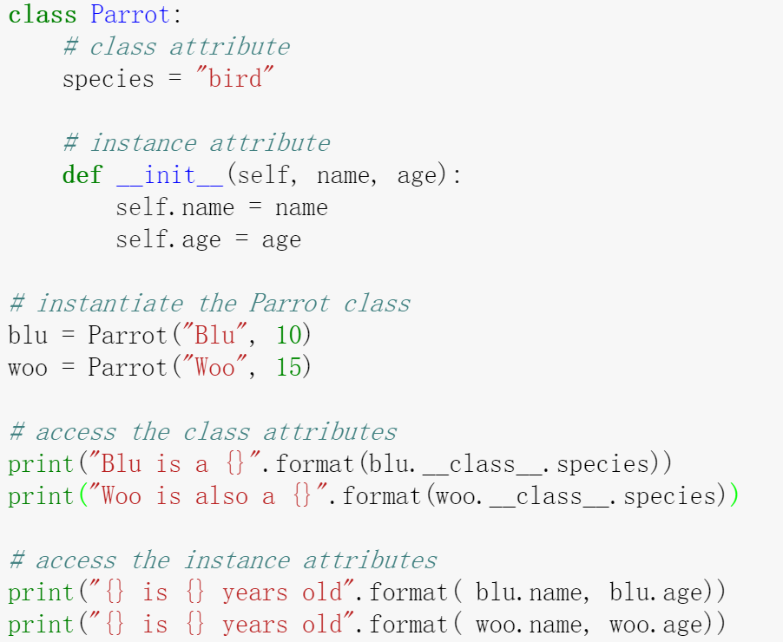
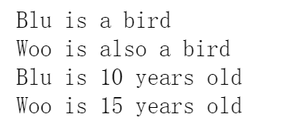
Create class and object
A class is a blueprint for the object. An object (instance) is an
instantiation of a class.

Slide 66
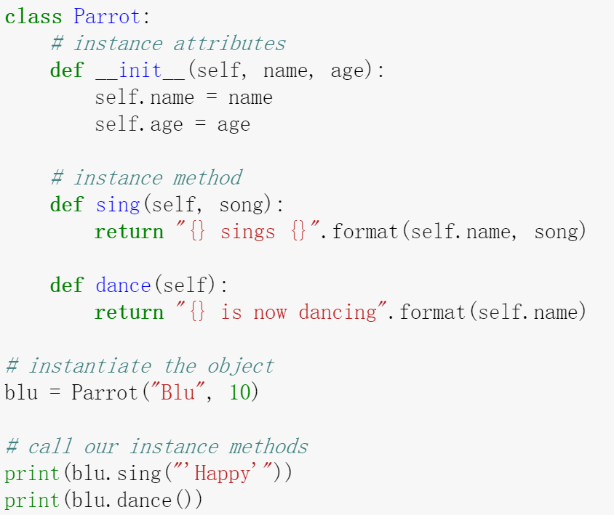

Create methods
Methods are functions defined inside the body of a class.
They are used to define the behaviors of an object.

Slide 67
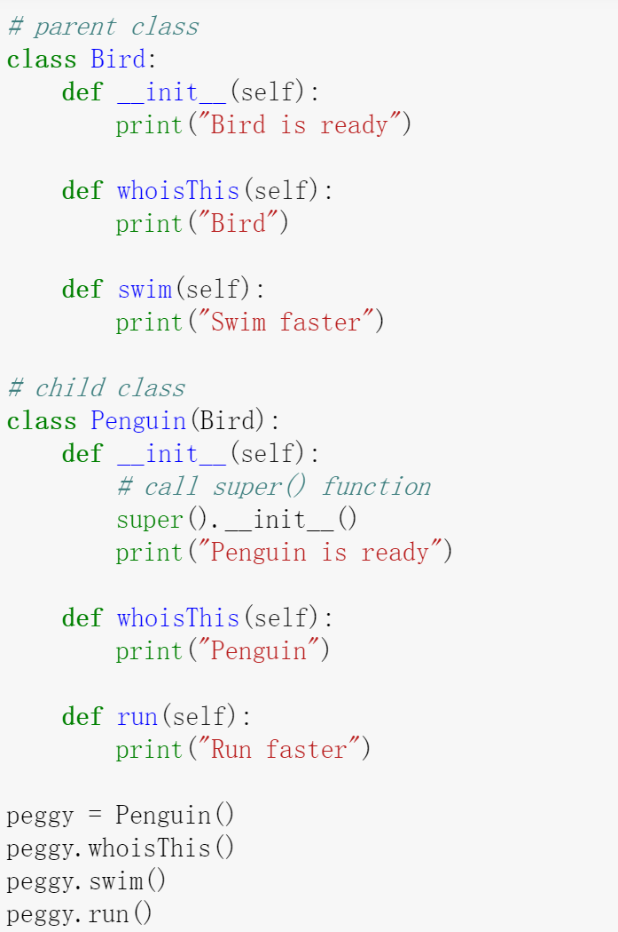
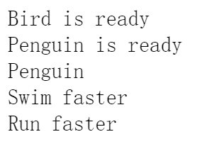
Inheritance
Inheritance is a way of creating new class for using
details of existing class without modifying it.
The newly formed class is a derived class (or child
class). Similarly, the existing class is a base class
(or parent class).

Slide 68
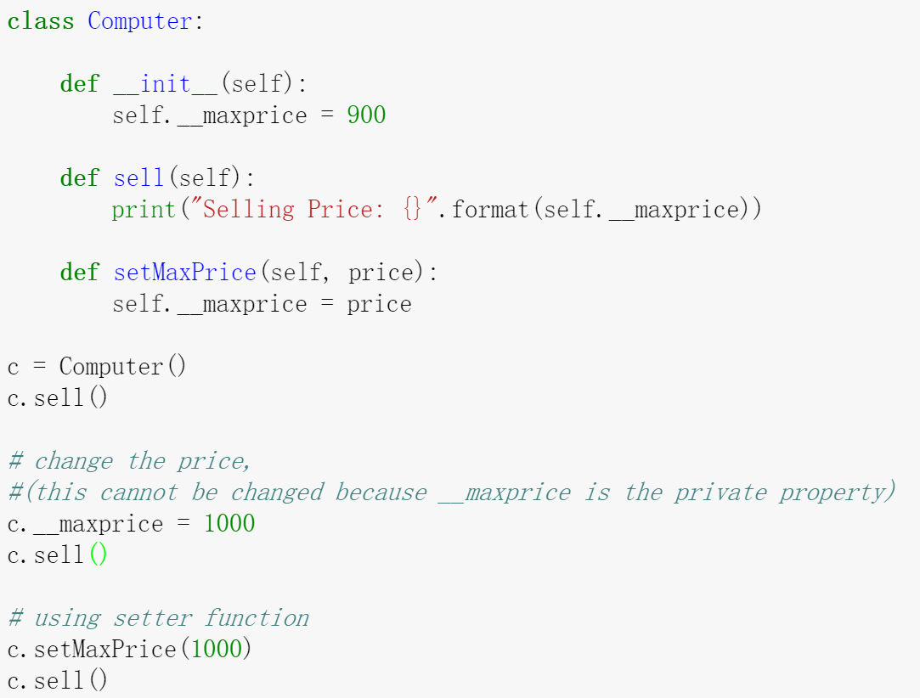
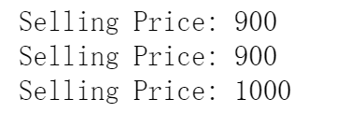
Encapsulation
Using OOP in Python, we can restrict
access to methods and variables.
This prevent data from direct
modification which is called
encapsulation. In Python, we denote
private attribute using underscore as
prefix i.e single “ _ “ or double “ __“.

Slide 69
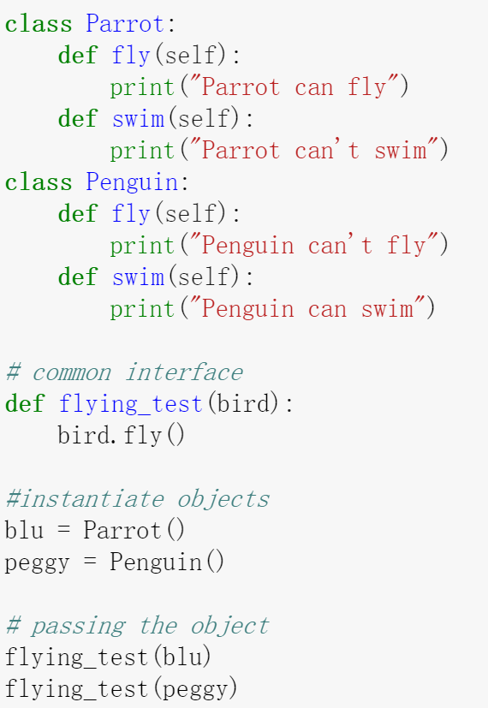

Polymorphism
Polymorphism is an ability (in OOP) to use common interface for multiple form.
Suppose, we need to color a shape, there are multiple shape option (rectangle, square, circle).
However we could use same method to color any shape. This concept is called Polymorphism.

Slide 70

4. Importing and Modules

Slide 71
Import and Modules
Programs will often use classes & functions defined in another file
A Python module is a single file with the same name (plus the .py
extension)
Modules can contain many classes and functions
Access using import
Where does Python look for module files?
The list of directories where Python looks: sys.path
When Python starts up, this variable is initialized from the PYTHONPATH environment variable
To add a directory of your own to this list, append it to this list.
sys.path.append(‘/my/new/path’)

Slide 72
Import and Modules
import somefile
Everything in somefile.py can be referred to by: somefile.className.method(“abc”) somefile.myFunction(34)
from somefile import *
Everything in somefile.py can be referred to by: className.method(“abc”) myFunction(34)
Careful! This can overwrite the definition of an existing function or variable!

Slide 73
Import and Modules
from somefile import className
Only the item className in somefile.py gets imported.
Refer to it without a module prefix.
Caveat! This can overwrite an existing definition.
className.method(“abc”)
This was imported
myFunction(34)
Not this one

Slide 74
Commonly used modules for scientific computing
Numpy
Matrix calculation
Scipy
Numeric calculation
Scikit-learn
Machine learning
Matplotlib
Plotting
Seaborn
Plotting

Slide 75

Section 2: Scientific computing
5. Numpy
import numpy as np

Slide 76
Why numpy?
Used in almost all numerical computations in Python • Used for high-performance vector and matrix computations • Provides fast precompiled functions for numerical routines • Written in C and Fortran • Vectorized computations

Slide 77
Arrays
>>> import numpy as np
>>> v = np.array ([1 ,2 ,3 ,4])
# the argument to the array function is a Python list
>>> M = np.array ([[1 , 2], [3, 4]])
# the argument to the array function is a nested Python list
>>> type (v), type (M) ( numpy . ndarray , numpy . ndarray )

Slide 78
Arrays
>>> v.shape , M. shape ((4 ,) , (2, 2))
>>> M. size 4
>>> M. dtype dtype (’int32’)
# Explicitly define the type of the array
>>> M = np.array ([[1 , 2], [3, 4]] , dtype=complex )

Slide 79
Arrays - Using array-generating functions
>>> np.arange (0, 10, 1) # arguments : start , stop , step array ([0, 1, 2, 3, 4, 5, 6, 7, 8, 9])
>>> np.linspace (0,10,11)
# arguments : start , end and number of points (start and end points are included ) array ([ 0., 1., 2., 3., 4., 5., 6., 7., 8., 9., 10.])

Slide 80
Mgrid
>>> x,y = np.mgrid [0:3 ,0:2]
>>> x array ([[0 , 0], [1, 1], [2, 2]])
>>> y array ([[0 , 1], [0, 1], [0, 1]])

Slide 81
Diagonal and zero matrix
>>> np.diag ([1 ,2 ,3]) array ([[1 , 0, 0], [0, 2, 0], [0, 0, 3]])
>>> np.zeros ((3 ,3) ) array ([[ 0., 0., 0.] , [ 0., 0., 0.] , [ 0., 0., 0.]])

Slide 82
Array access
>>> M = np.random . rand (3 ,3) # not a Numpy function
>>> M array ([ [ 0.37389376 , 0.64335721 , 0.12435669] , [ 0.01444674 , 0.13963834 , 0.36263224] , [ 0.00661902 , 0.14865659 , 0.75066302]])
>>> M[1 ,1] 0.13963834214755588

Slide 83
Array access
# Access the first row >>> M [0] array ([0.01444674 , 0.13963834 , 0.36263224])
# The first row can be also be accessed using this notation >>> M[0 ,:] array ([ 0.01444674 , 0.13963834 , 0.36263224])
# Access the first column >>> M[: ,0] array ([0.64335721 , 0.13963834 , 0.14865659])
Note: The first element in array is indexed by 0. Important!!!

Slide 84
Array access
# You can also assign values to an entire row or column
>>> M[1 ,:] = 0
>>> M
array ([
[ 0.37389376 , 0.64335721 , 0.12435669] ,
[ 0. , 0. , 0. ],
[ 0.00661902 , 0.14865659 , 0.75066302]])
检索+赋值 实现替换值得功能

Slide 85
Array slicing
# Extract slices of an array
>>> M[1:3]
array([
[ 0. , 0. , 0. ],
[ 0.00661902 , 0.14865659 , 0.75066302]])
>>> M[1:3 ,1:2]
array ([
[ 0. ],
[ 0.14865659]])
Note: M[a:b] will return the elements indexed from a to b-1.

Slide 86
Array slicing — Negative indexing
# Negative indices start counting from the end of the array
>>> M[-2]
array ([0., 0., 0.])
>>> M[-1]
array([0.00661902, 0.14865659, 0.75066302])
如果array是二维的话，检索时 只写一个 则表示所有的 列 都将被检索出来
Note: -1 is the index of the right-end element

Slide 87
Array access — strided access
# Strided access, [start_index: end_index(not_including): stride]
>>> M [::2 ,::2]
array ([[ 0.37389376 , 0.12435669] ,
[ 0.00661902 , 0.75066302]])
>>> M [:-1:2 ,:-1:2]
array ([[ 0.37389376]])

Slide 88
Array operations — Scalar
These operation are applied to all the elements in the array
>>> M*2 array ([ [ 0.74778752 , 1.28671443 , 0.24871338] , [ 0. , 0. , 0. ], [ 0.01323804 , 0.29731317 , 1.50132603]])
>>> M + 2 array ([ [ 2.37389376 , 2.64335721 , 2.12435669] , [ 2. , 2. , 2. ], [ 2.00661902 , 2.14865659 , 2.75066302]])

Slide 89
Array operations — matrix multiplication
>>> M * M # Element - wise multiplication
array ([
[1.397965e-01, 4.139085e-01, 1.546458e-02] ,
[0.000000e+00, 0.000000e+00, 0.00000e+00] ,
[4.381141e-05, 2.209878e-02, 5.634949e-01]])
>>> np.dot(M,M) # Matrix multiplication, equals to np.matmul(M,M)
array ([
[0.14061966 , 0.25903369 , 0.13984616] ,
[0. , 0. , 0. ],
[0.00744346 , 0.1158494 , 0.56431808]])
点乘 即 向量的乘法

Slide 90
Iterating over Array Elements
• In general, avoid iteration over elements • Iterating is slow compared to a vector operation • If you must, use the for loop • In order to enable vectorization, ensure that user-written functions can work with vector inputs. • Use the vectorize function • Use the any or all function with array

Slide 91
Vectorize
>>> def Theta (x):
"""
Scalar implemenation of the Heaviside step function .
"""
if x >= 0:
return 1
else :
return 0
>>> Theta (1.0)
1
>>> Theta ( -1.0)
0
函数的矢量化
在实际的情况下，我们一般使用 列表表达式来替代函数的矢量化

Slide 92
Vectorize
Without vectorize we would not be able to pass v to the function
>>> v = np.arange(1,5)
array ([1 , 2, 3, 4])
>>> Tvec = np.vectorize ( Theta )
>>> Tvec (v)
array ([1 , 1, 1, 1])
>>> Tvec (1.0)
array (1)

Slide 93
Arrays in conditions
Use the any or all functions associated with arrays
>>> v array ([1 , 2, 3, 4])
>>> (v > 3). any () True # True if there is one element meets the condition
>>> (v > 3). all () False # True if there all of the elements meet the condition

Slide 94

6. Scipy

Slide 95
Scipy
SciPy framework built on top of the NumPy framework
SciPy imports all the functions from the NumPy namespace
Scipy can realize large number of scientific algorithms
Integration
Optimization
Linear Algebra
Sparse Eigenvalue Problems
Statistics
File I/O
Fourier Transforms
... and many more

Slide 96
Subpackages
Using any of these subpackages requires an explicit import
Linear Algebra
Optimization
Integration

Slide 97
Linear Algebra
To solve an equation of the form Ax = b
>>> from scipy import * >>> from scipy import linalg >>> A = np.array([[1 ,2 ,3] , [4 ,5 ,6] , [7 ,8 ,9]]) >>> b = np.array([1 ,2 ,3])
>>> x = linalg.solve(A, b) array ([ -0.33333333 , 0.66666667 , 0. ])
>>> linalg.norm(dot(A, x) - b) #validate 1.1102230246251565 e -16
解两个矩阵 用solve函数！
求 矩阵的解

Slide 98
Linear Algebra - Inverse
>>> A = np.random.rand(3 ,3) >>> A array ([ [ 0.24514116 , 0.52587023 , 0.18396222] , [ 0.90742329 , 0.16622943 , 0.13673048] , [ 0.09218907 , 0.51841822 , 0.5672206 ]])
>>> linalg.inv (A) array ([ [ -0.13406351 , 1.16228558 , -0.23669318] , [ 2.87602299 , -0.69932327 , -0.76418374] , [ -2.60678741 , 0.45025145 , 2.49988679]])
矩阵的逆

Slide 99
Linear Algebra – Eigenvalues and Eigenvector
求特征值和和特征向量
>>> evals, evecs = linalg.eig(A) >>> evals array ([-0.46320383+0.j, 1.09877378+0. j, 0.34302124+0. j])
>>> evecs array ([ [ -0.49634545 , 0.49550686 , -0.20682981] , [ 0.79252573 , 0.57731361 , -0.35713951] , [ -0.35432211 , 0.64898532 , 0.91086377]])

Slide 100
Optimization
Compute the minima of a single variable function
>>> from scipy import optimize >>> def f(x): return 4*x**3 + (x -2) **2 + x**4

Slide 101
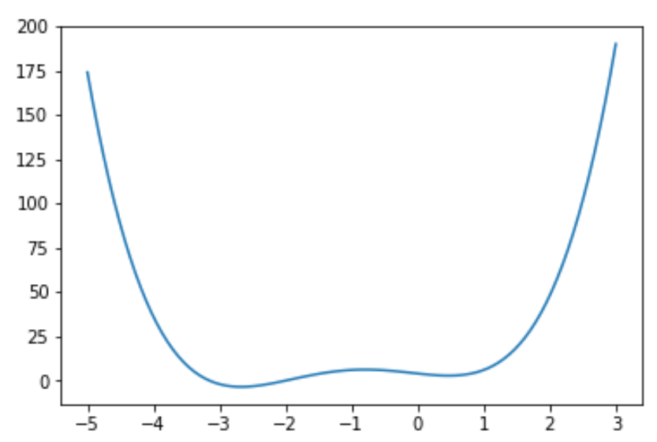
Optimization

Slide 102
Optimization
求最优解
>>> x_min = optimize.fmin_bfgs(f, -2)
Optimization terminated successfully . Current function value : -3.506641 Iterations : 6 Function evaluations : 30 Gradient evaluations : 10
>>> x_min
array ([ -2.67298167])

Slide 103
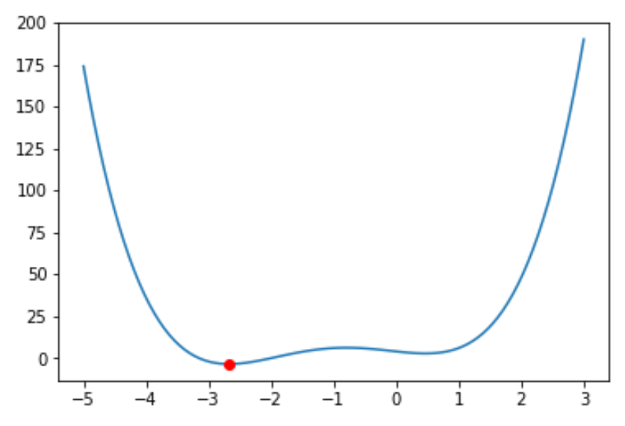
Optimization
Minimum point

Slide 104
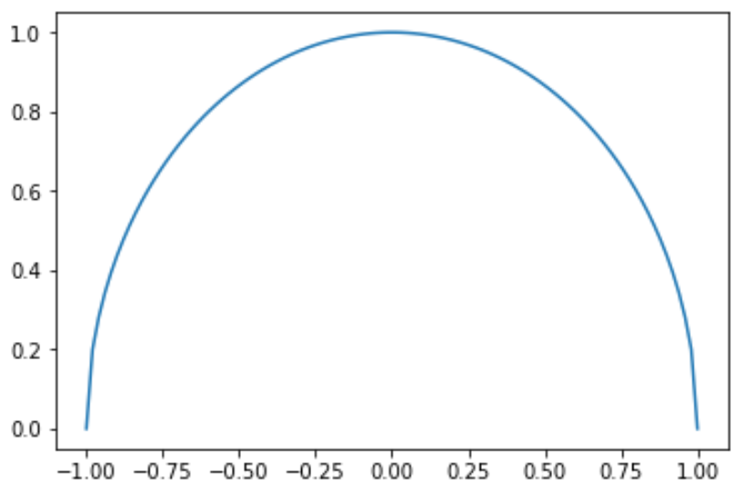
Integration
>>> def half_circle(x):
return (1-x**2)**0.5

Slide 105
Integration
Calculate the area of the half circle
>>> from scipy import integrate
>>> pi_half, err = integrate.quad(half_circle, -1, 1)
>>> pi_half*2
3.141592653589797
>>> err
1.0002356720661965e-09

Slide 106
Statistics
>>> from scipy import stats
>>> X = stats.norm(loc=1.0, scale=2.0)
#loc is the mean value, scale is the standard deviation
>>> x = X.rvs(size=10000) # get 10000 samples from random variable
>>> np.mean(x)
1.0235502154314298
>>> np.std(x)
1.999466195598207

Slide 107
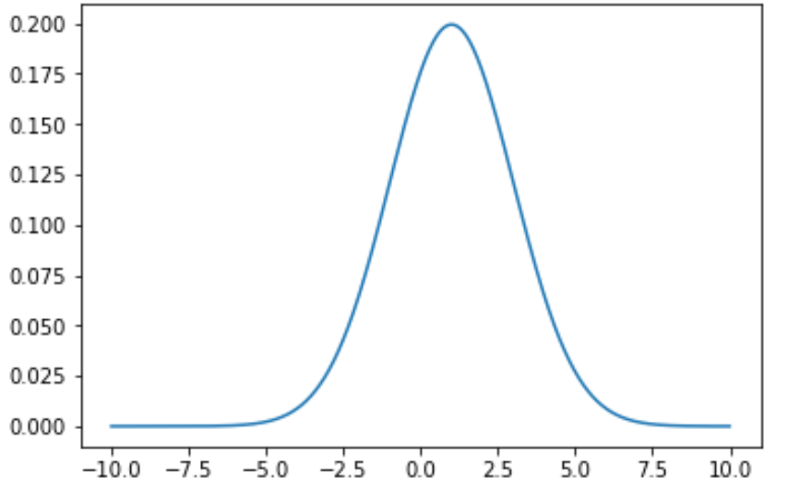
Statistics
>>> import matplotlib.pyplot as plt # will be introduced later
>>> t = np.arange(-10,10,0.01)
>>> plt.plot(t, X.pdf(t))

Slide 108

7. Matplotlib

Slide 109
Matplotlib
Used for generating 2D and 3D scientific plots
Support for LaTeX
Fine-grained control over every aspect
Many output file formats including PNG, PDF, SVG, EPS
Matplotlib is the entire library
Pyplot - a module within Matplotlib that provides access
to the underlying plotting library
Please look up help documentation for further illustrations
of parameter settings

Slide 110
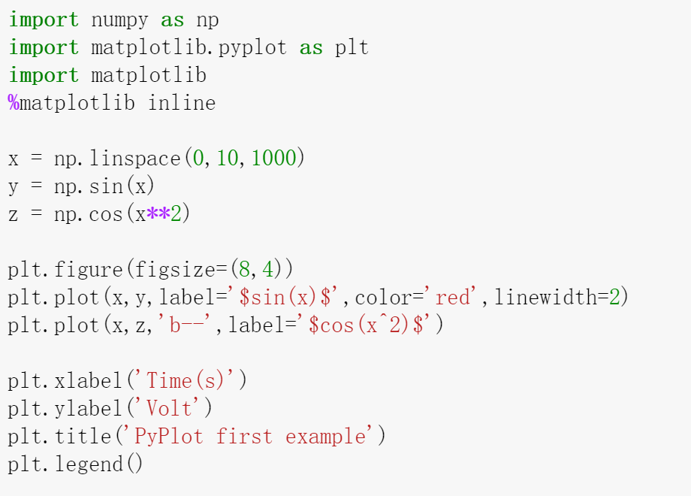
pyplot — first example
Notes:
Label, color, linewidth, legend,

Slide 111
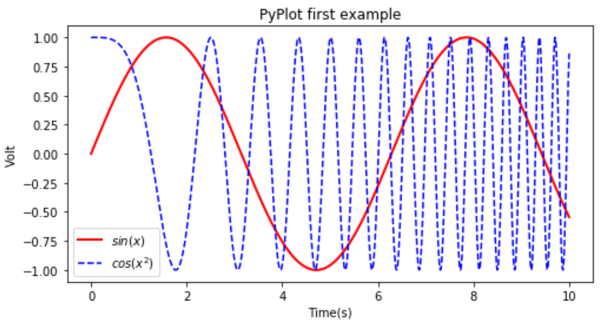
pyplot — first example

Slide 112
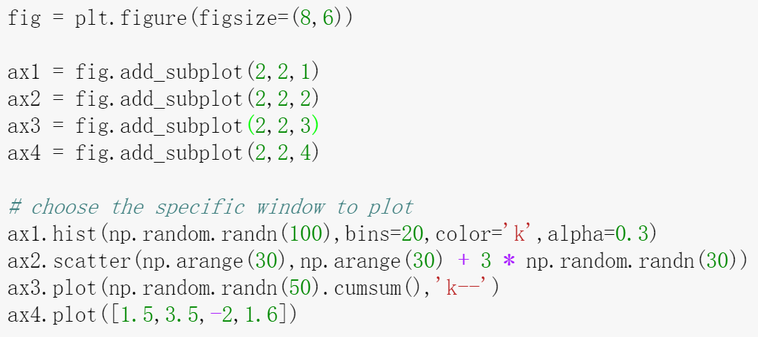
subplots

Slide 113
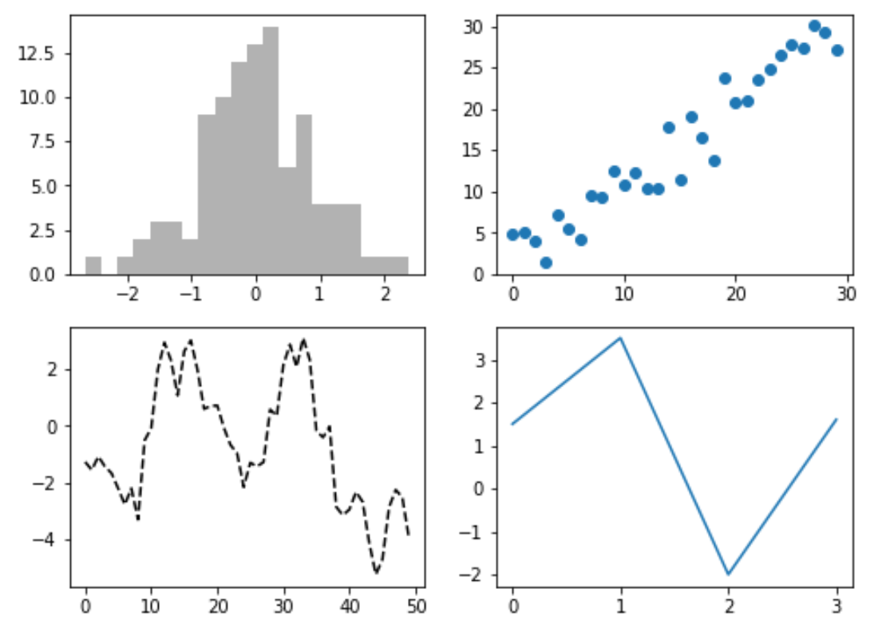
subplots

Slide 114
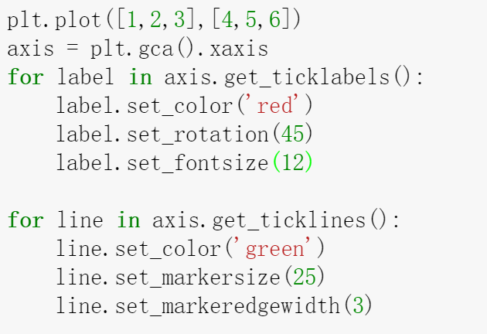
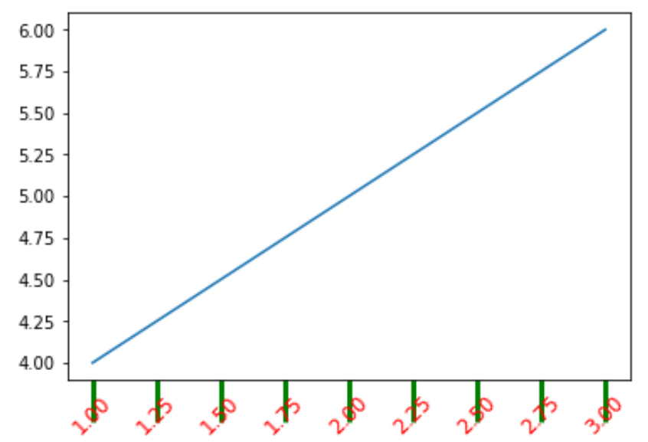
Set ticklabels of axis

Slide 115
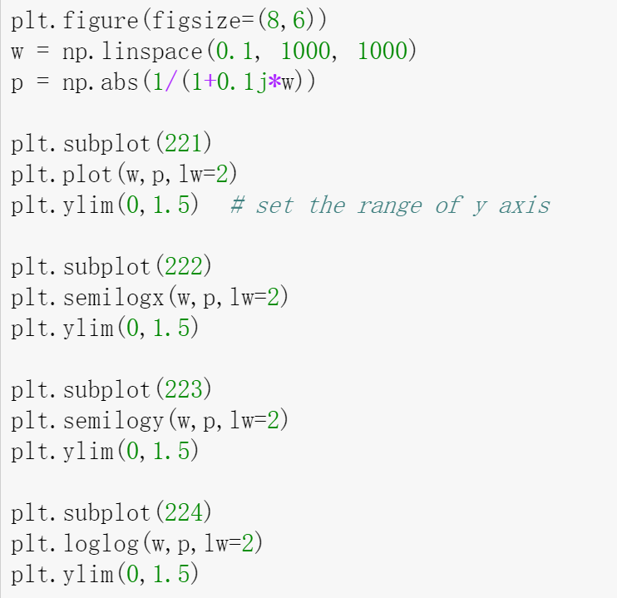
Logarithmic plot

Slide 116
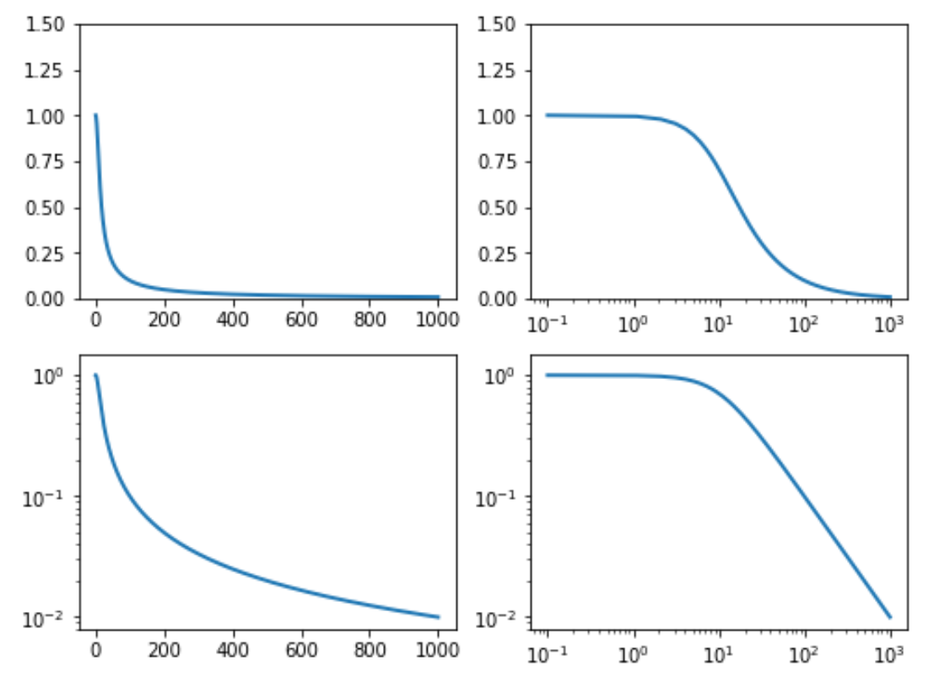
Logarithmic plot

Slide 117
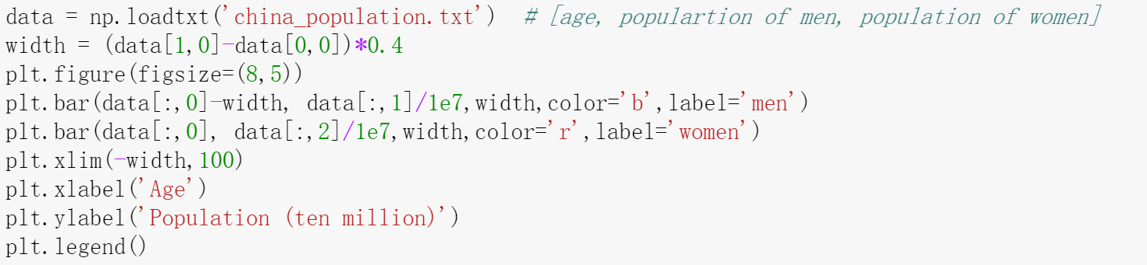
Histogram

Slide 118
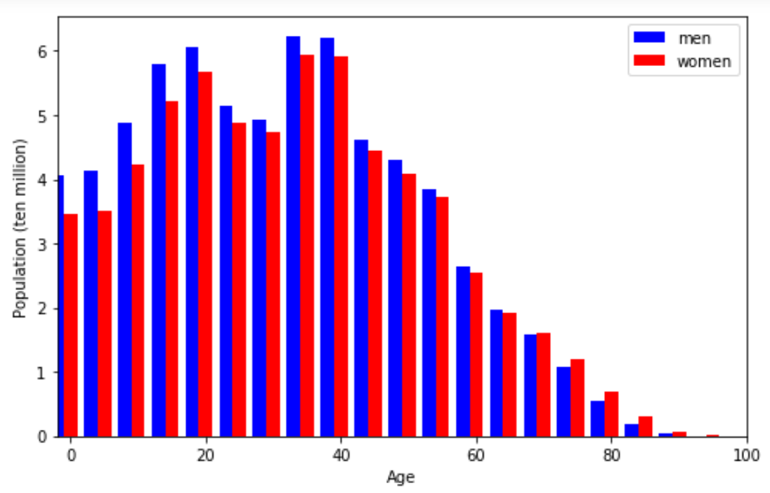
Histogram

Slide 119
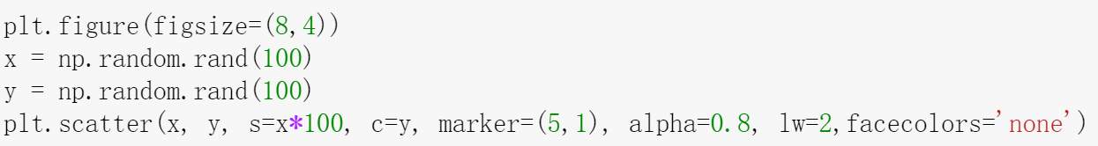
Scatter plot

Slide 120
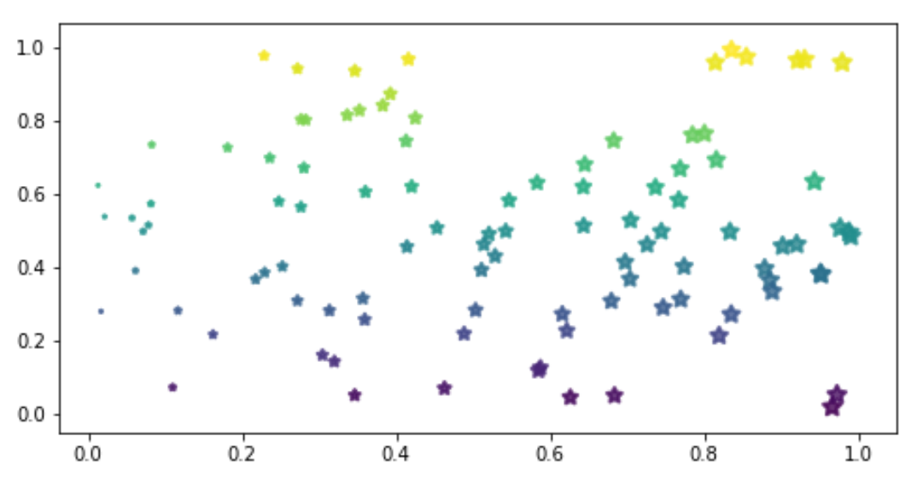
Scatter plot

Slide 121
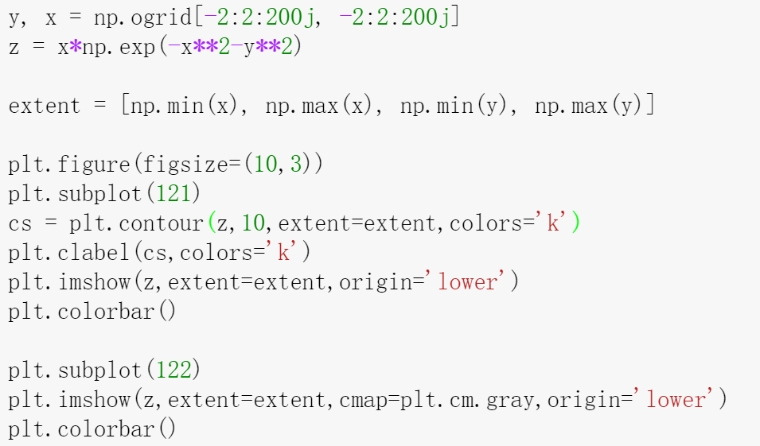
Image visualization and contour

Slide 122
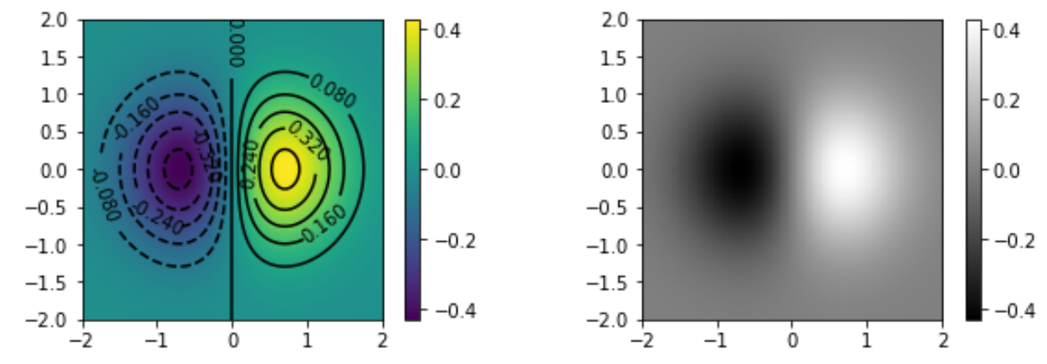
Image visualization and contour

Slide 123
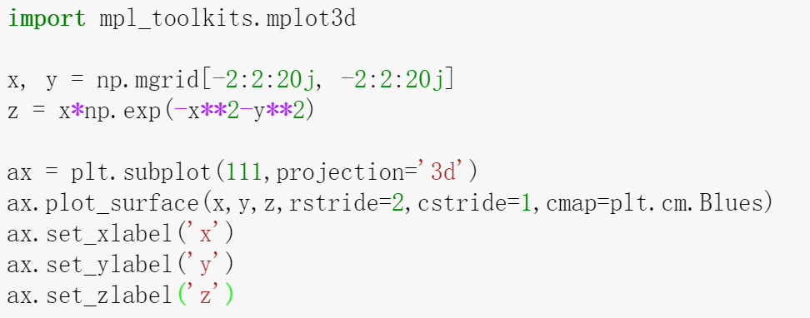
3D plotting

Slide 124
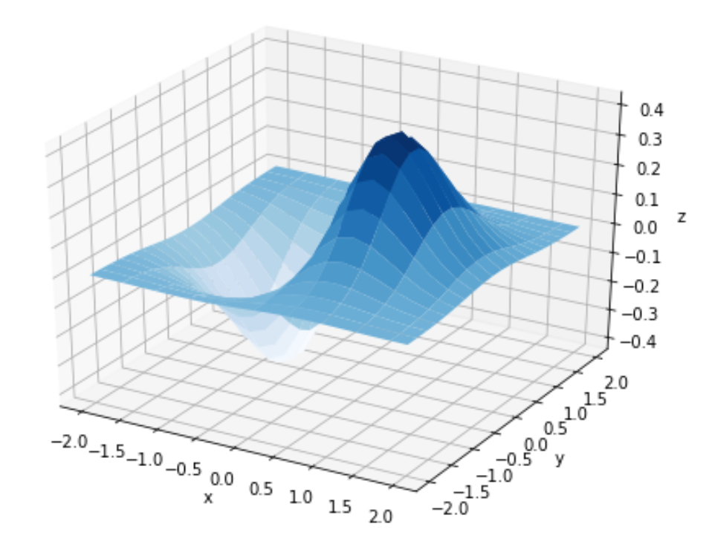
3D plotting

